Slide 1
MAIN DETAILS
PROJECT DETAILS
NAME: 3-Bedroom Detached House Show Home |  |  |  | SITE ADDRESS: <site address> |  |  |  | CLIENT NAME: <client name>
CONTRACTOR DETAILS
NAME: <CARPENTER’s name> | ADDRESS: <CARPENTER’s address > | PHONE |  | E-MAIL: <CARPENTER’s e-mail>
 |  | office: <###> | mobile: <###>
GENERAL NOTES
1/ | Please review this concept design with all estimated/suggested details and let me know of any possible issues, ideas for improvement and/or recommendations so that the concept can be firmed up and finalized before work can commence.
2/ | Please see concept visualization and estimated dimensions in the (D15) Under-stairs Built-in Storage Concept Elevation drawing. For quick view, a fit-to-screen (not to scale) version of this drawing is also provided in Section 3 - Concept Elevation (Note: The inside elements of the compartments are shown in grey ink.) To see the staircase on a floor plan, please consult drawings (D3) Flooring – Ground Floor, (D4)Flooring – First Floor.
3/ | This storage solution concept is inspired by the clean-lined and minimalist Leopoldo Rosati’s Under-Stairs Storage Solution. Please see image at: http://leopoldorosati.com/2011/09/mercer-loft-soho-manhattan/03-26-resized/
ASSUMPTIONS
1/ | The space under the staircase is available and not used for any other purpose.
2/ | The unit rise of the stairs is 190 mm.
3/ | The unit tread of the stairs is 250 mm.

Slide 2
CONCEPT DETAILS
# | DESCRIPTION
1/ | The storage solution is to have 3 main compartments and 3 doors. From the left: the first compartment is to have a cover panel, the second – one door, and the third, largest - 2 doors in a gate-like manner.
2/ | For the cabinet doors, push-to-open or other minimally visible hardware is to be used to achieve a clean, minimalist look.
3/ | The width of the staircase under which the built-in storage is to be installed is 900 mm. In regards to the depth of the storage compartments, storage space is to be maximized as much as the construction allows.
4/ | The first leftmost compartment (C1) is to have no door of its own (simply a cover panel) and is to be accessed through its neighbouring compartment to the right. This will allow for the placement of a coat stand in the stairs corner without obstructing any door from opening while still utilizing the storage space.
5/ | The second main compartment (C2) starting from the left is to have one door which is to open into a space containing two pullout shelves in the top half (as shown on the Concept Elevation, Section 3) with the bottom part left unobstructed for the storage of boots, shoes, etc. which is also to provide access to the storage space to the left (as explained above).
6/ | The third main rightmost and largest compartment (C3) is to have 2 doors that are to open in a gate-like manner into a walk-in space that is to house corner shelving utilizing the space to the left and a hanger rod attached to the slanted ceiling and the wall to the right (Please see the Concept Elevation (Section 3) for placement and dimensions).
7/ | Suggested widths and heights for the interior elements (shelves and hanger rod) and their placement heights can be obtained from the separately provided scaled Concept Elevation drawing using a scale ruler (These dims are not explicitly shown to avoid over-cluttering).
8/ | All shelving, incl. pullouts, are to extend from the back wall to the front door as much as it is practical and allowed by construction limitations.
9/ | The hanger rod in compartment C3 is to be placed at an appropriate distance from the back wall (approx. 300 mm) in order to allow enough space for its use with standard hangers.
10/ | The corner shelves in compartment C3 are to have a depth of 240 mm (suggested).
11/ | The exterior is to be painted off-white with the same paint used for the walls in the Hall: Dulux Lifemaster Zero VOC. 50YY 83/029, Natural White, Eggshell.
12/ | In regards to the illumination of the interior compartments, LED strip lights (such as Armacost Lighting LED tape lights) are suggested. Please advise on any possible issues and/or alternative solutions.

Slide 3
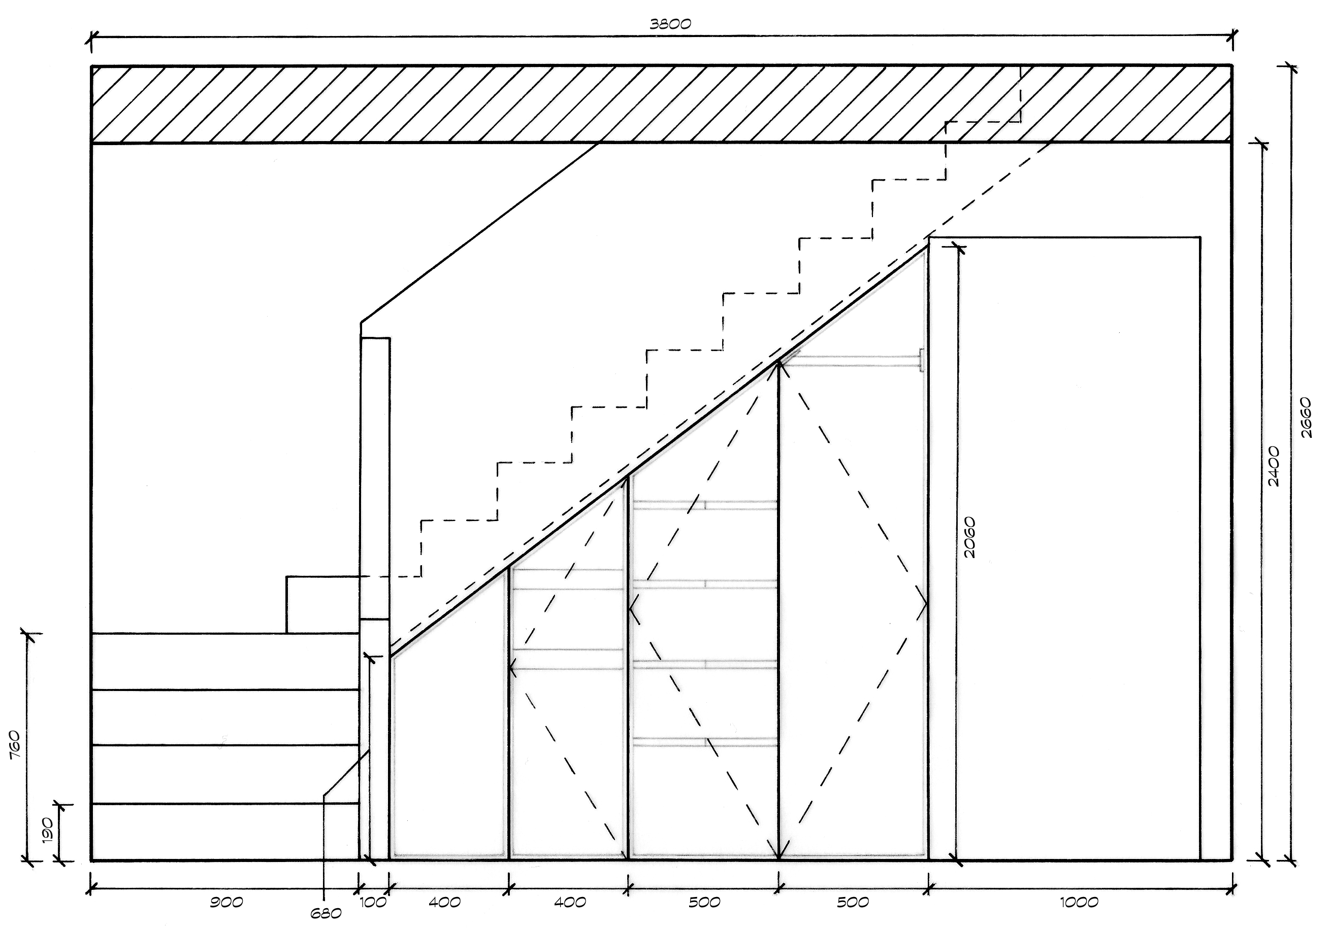
CONCEPT ELEVATION
Floor Section between
Ground and First Levels
(included to show complete
stairs distribution)
Pullout
Shelves
Hanger Rod
NB:
All dimensions in mm.
Only basic simplified outlines are shown of the surroundings of the under-stairs storage (i.e. stairs, railing, door etc. ).
Drawing is not shown to scale. Scaled version provided in the Drawings/Elevations folder of this project package.
Corner
Shelving

